Slide 1
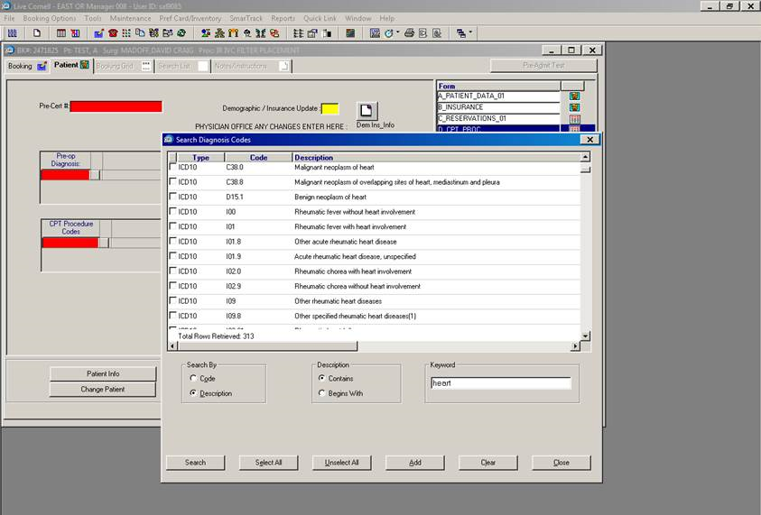
OR Manager ICD10 Update
You will no longer be able to select ICD-9 codes in OR Manager for services scheduled on or after 10/1/2015.

Slide 2
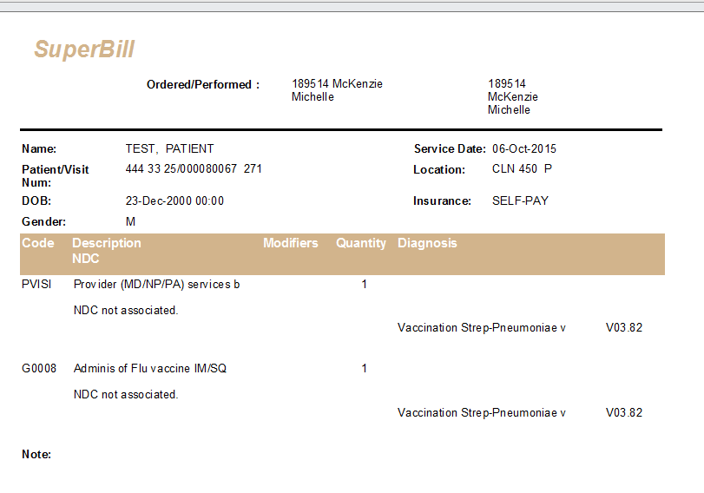
OR Manager ICD10 Update
You will no longer be able to select ICD-9 codes in OR Manager for services scheduled on or after 10/1/2015.
ICD-10 Codes will not appear on the print screen prior to printing the SuperBill the print screen has not been formatted to do so

