Slide 1
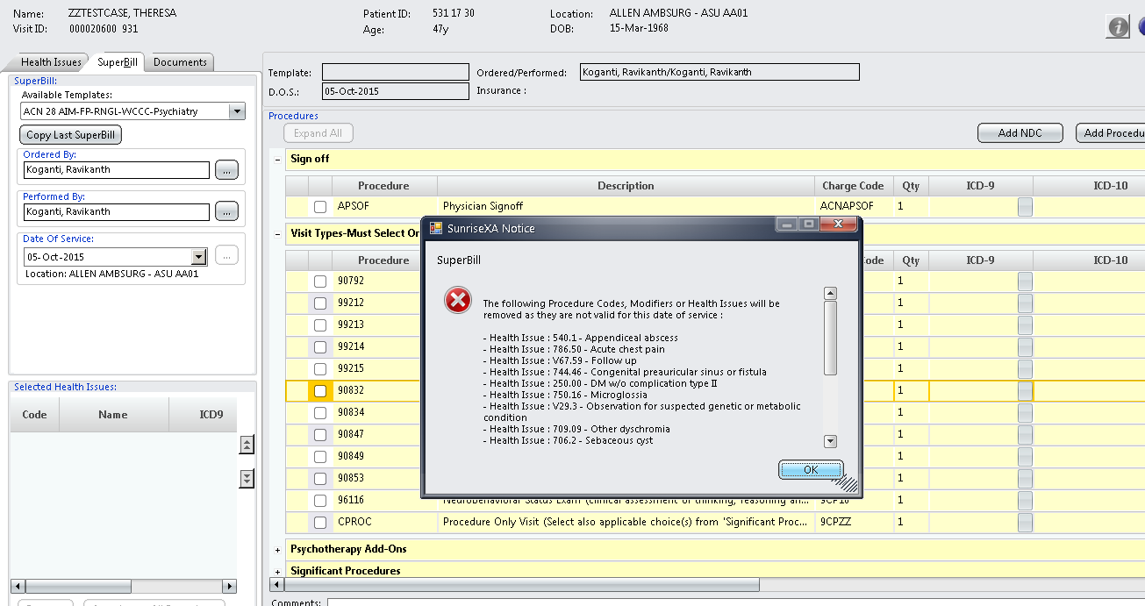
Superbill Notification
Upon creating a new Superbill, you will no longer be able to select IDC9 codes. Only ICD10 codes will be accepted for dates of service of 10/1/2015 and onwards.

